Slide 1

A Low-Code LLM-Based Conversational AI
Assistant for ERP Systems
Supervisor
Dr. THIRUMAL M.E, Ph.D., Associate Professor Department of CSE VISTAS, Chennai
Thanigaivel G - 24880107
MTECH- CSE – II Year

Slide 2
Abstract
Enterprise Resource Planning (ERP) systems are essential for managing business processes but are often complex and difficult to use for non-technical users. With the rise of AI, particularly Large Language Models (LLMs), it is now possible to create intelligent conversational agents that can simplify how users interact with such systems.
This project proposes a low-code AI-based conversational assistant integrated into an ERP system using Oracle APEX. It combines LLMs with a Retrieval-Augmented Generation (RAG) framework to understand and respond to natural language queries using real-time data from ERP databases and documents.
The assistant enables users to interact with ERP modules using natural language, thereby improving usability, accessibility, and productivity. Leveraging low-code development platforms and state-of-the-art LLMs like GPT-4, the solution offers a scalable and adaptable approach to ERP interaction, reducing dependency on technical expertise.
Advantages:
Enables business users to query ERP systems using everyday language.
Reduces dependency on technical staff for ERP navigation.
Demonstrates a low-code approach that speeds up development.
Bridges modern AI with legacy enterprise infrastructure.
2

Slide 3
Problem Inferred
Current ERP systems are rich in functionality but poor in user experience for most employees. They demand significant user training and technical knowledge and users often struggle with accessing the right data or performing actions quickly, leading to reduced productivity and increased operational costs.
A solution is needed to:
Simplify ERP interactions using natural language.
Minimize the need for extensive coding or customization.
Improve ERP accessibility for non-technical users
Key problems identified include:
Complex UI & workflows: Most ERP interfaces are designed for power users, not general staff.
Lack of intuitive search: Searching for information like "What is my pending leave balance?" often requires navigating multiple screens.
IT dependency: Non-technical users often rely on IT or ERP admins to run reports or queries.
No contextual help: Current ERP systems lack AI-driven assistance or recommendations based on prior interactions. This leads to inefficiencies, delays, and reduced adoption of ERP features, which this project aims to address.

Slide 4
Objective
The primary objective of this project is to create a smart assistant that simplifies ERP interaction using AI while requiring minimal development effort through low-code tools.
Key Objectives:
Design a conversational assistant interface inside Oracle APEX.
Integrate LLMs to understand user queries and perform ERP actions.
Use a RAG model to retrieve relevant ERP documents and data.
Minimize technical overhead by using low-code tools and reusable components.
Sub-objectives:
Improve accessibility of ERP data and reports.
Build an extensible architecture for future ERP modules.
Provide a secure and scalable framework for enterprise use.

Slide 5
Scope of this Project
This project focuses on the design and development of a prototype AI assistant integrated into a low-code ERP platform. It does not aim to replace existing ERP systems but to enhance user interaction.
Within Scope:
Build a chatbot UI using Oracle APEX.
Connect the assistant to ERP data sources like employee, leave, or inventory modules.
Use LLMs to understand and respond to natural language queries.
Implement vector search to retrieve documents or past queries for better context.
Out of Scope (for now):
Voice-based assistants or speech recognition.
Real-time data syncing across multiple ERP platforms.
Full security and authorization layer beyond the prototype.

Slide 6
Proposed Work Outline
This system combines a low-code frontend, an AI-powered backend, and ERP data sources using a modular architecture.
Workflow Overview:
User types a query in the APEX chatbot interface.
The query is sent to a backend where it is embedded and matched with relevant ERP documents.
The LLM uses the retrieved context to generate a response.
The response is returned to the user with potential links to ERP actions.
System Layers:
Frontend: Oracle APEX with dynamic actions and RESTful APIs.
Middleware: Python (Flask) layer to handle AI operations.
RAG Engine: Uses LangChain or LlamaIndex to retrieve document chunks.
LLM Integration: GPT or open-source models to generate text.
Data Layer: Connects to Oracle ERP tables and document storage.

Slide 7
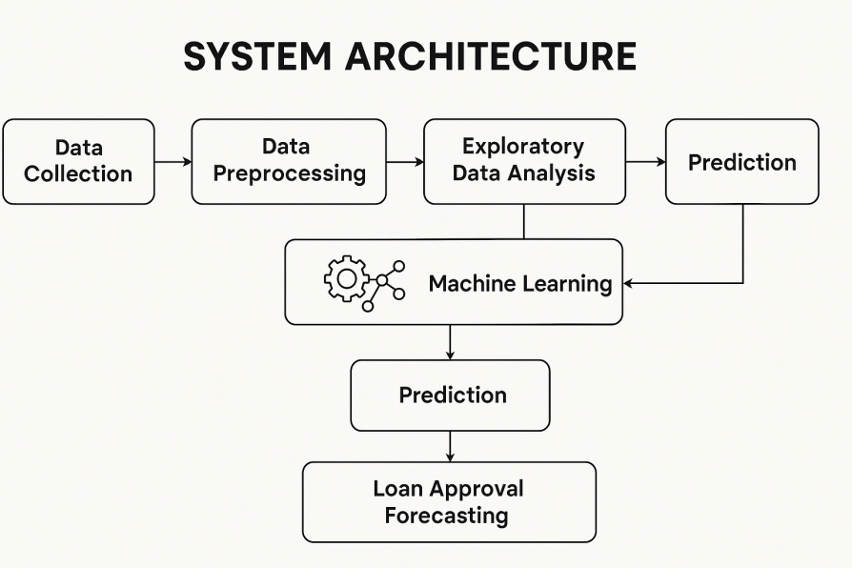
Block Diagram
7

Slide 8
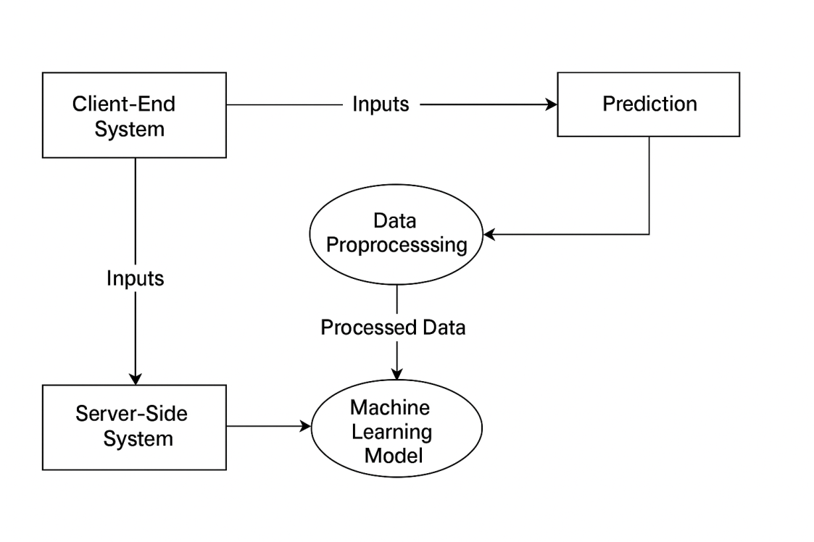
Overall Workflow Diagram

Slide 9
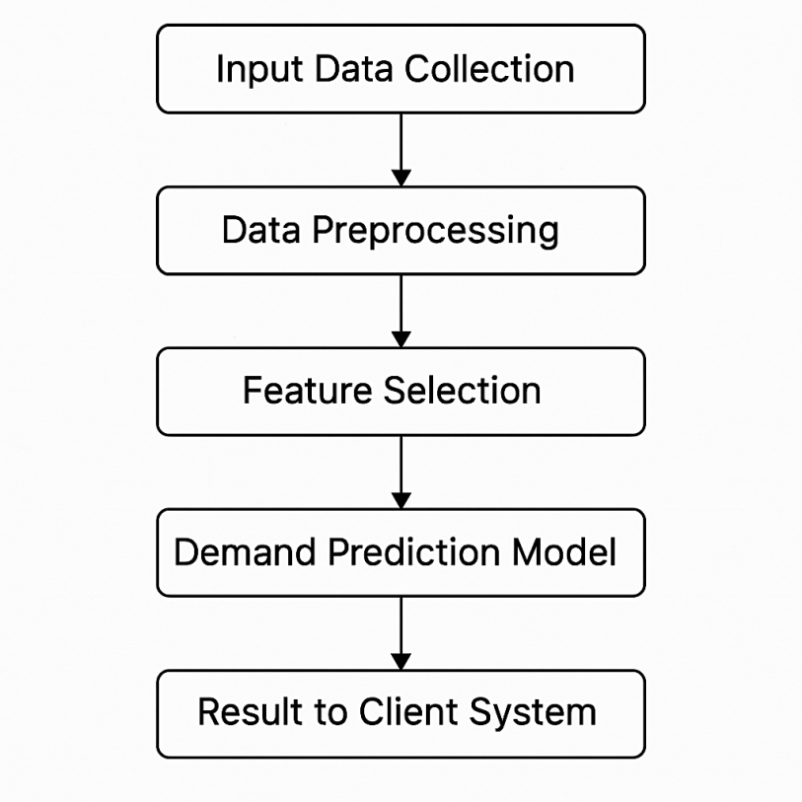
Module Flow Diagram

Slide 10
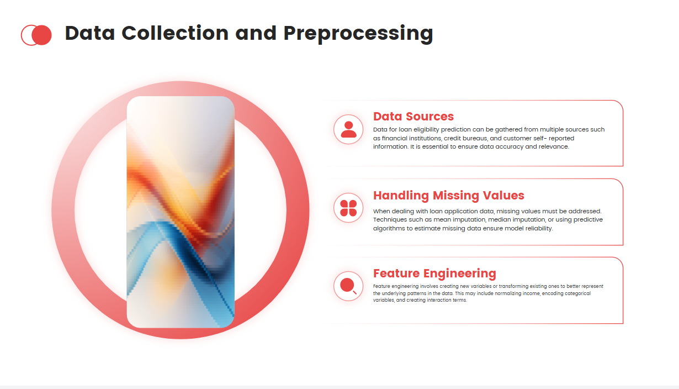
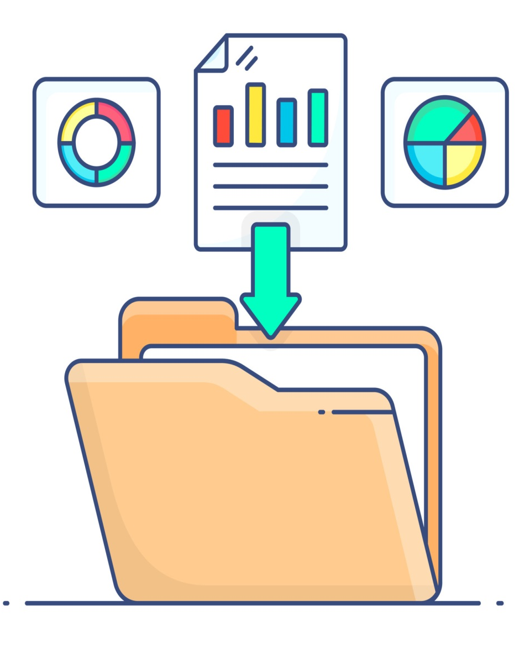

Slide 11
Feature Extraction
The process of identifying and selecting relevant attributes from raw data that can help the model make accurate predictions.
Converts real-world data into numerical inputs suitable for machine learning algorithms.
This helps in reducing noise and overfitting in the model creation.
Improves model accuracy and training speed.
Focuses the model on the most impactful variables.
Used Select K Best Method to extract the best Features.
Key Features Extracted
Age – Indicates the Age of the Loan Applicant.
Applicant Income – Indicates earning capacity.
Loan Amount – Determines the risk for the lender.
Cibil Score– Crucial indicator of creditworthiness.
Interest – Interest Percentage

Slide 12
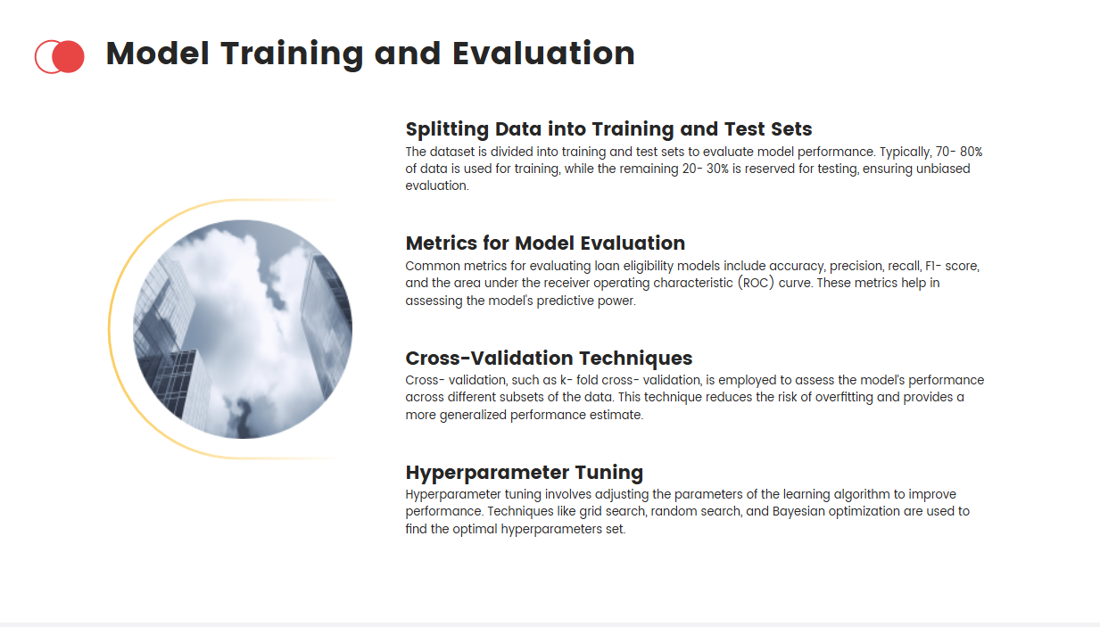
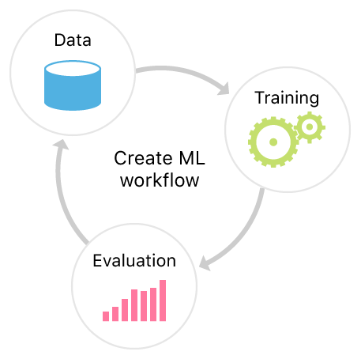

Slide 13

Minimum Hardware Requirements
Processor : Intel i3 or equivalent.
Storage : 256 GB HDD or SSD.
Monitor : 15 inch VGA Color.
Mouse : Logitech Mouse.
Ram : 4 GB
Keyboard : Standard Keyboard
GPU : Integrated GPU
Internet : Basic internet connection

Slide 14
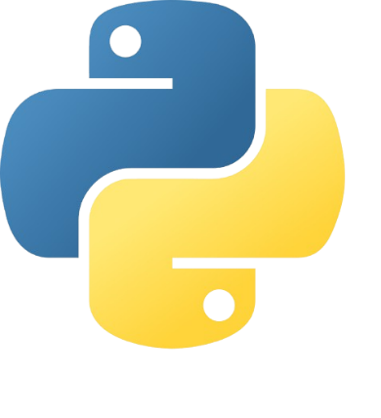


Tools & Technologies Used
Low-Code Platform:
Oracle APEX – For building UI, managing session state, and calling REST services.
LLM & AI Frameworks:
OpenAI GPT-4 / Cohere / HuggingFace Transformers
LangChain / LlamaIndex – For orchestrating the RAG
Storage & Retrieval:
ChromaDB / FAISS / Pinecone – Vector search for document embeddings
Oracle DB – Core ERP database
Languages & Protocols:
PL/SQL, JavaScript, Python
RESTful APIs for integration

Slide 15
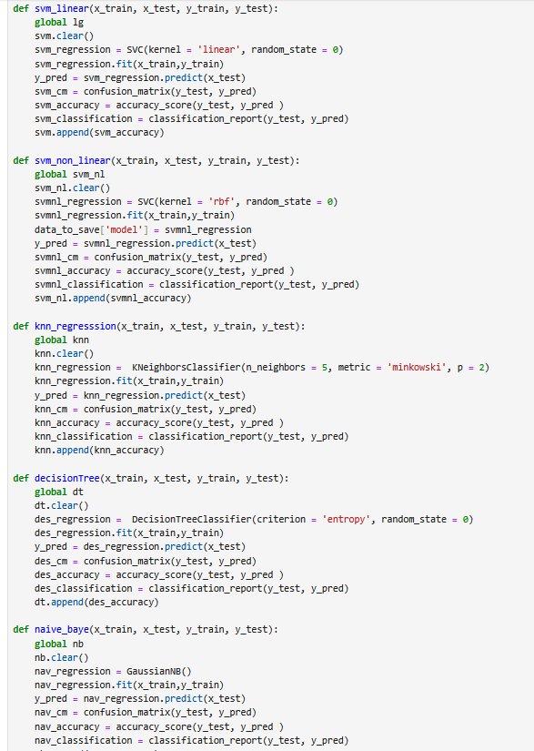
Algorithms

Slide 17
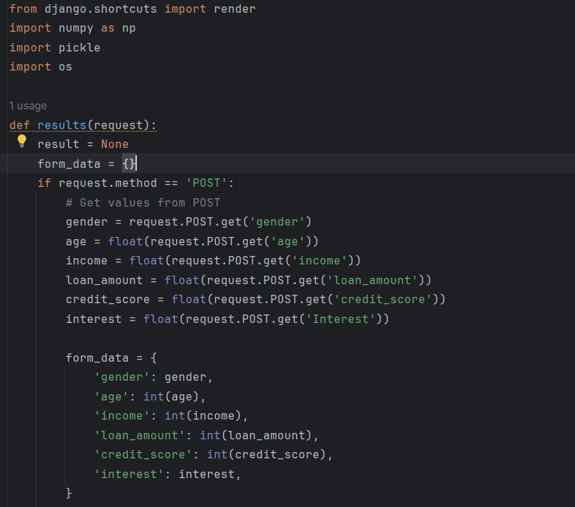
Deployment
(Django)

Slide 18
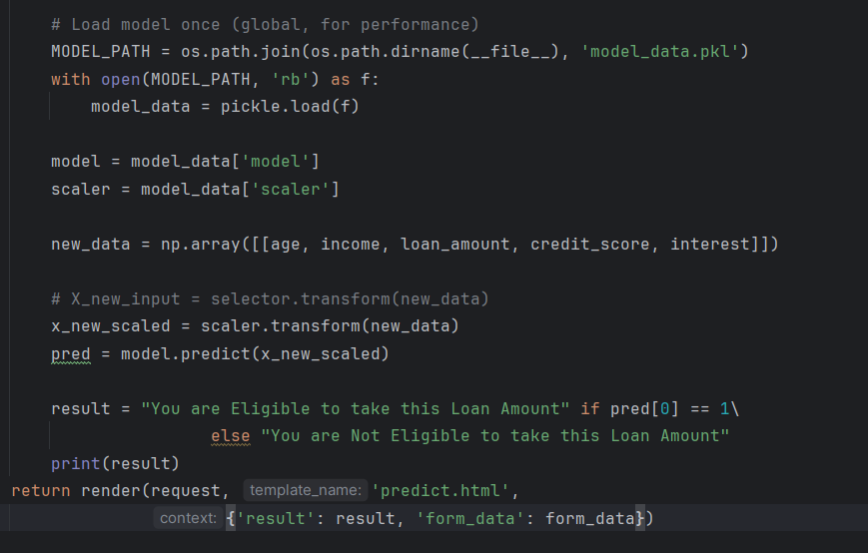

Slide 19
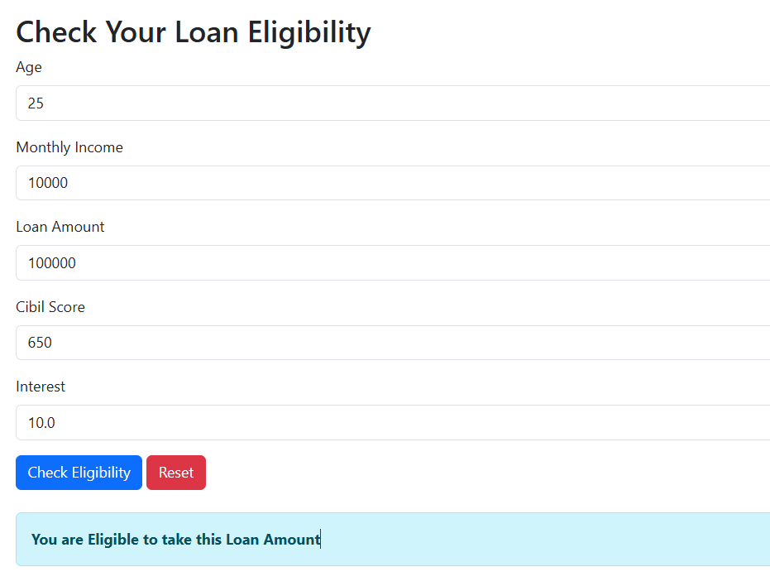
Output

Slide 20
Challenges
Technical Challenges:
Managing latency during real-time vector retrieval and LLM inference.
Token limitations of LLMs when processing large documents.
Security Concerns:
Ensuring sensitive ERP data is protected in transmission and inference.
Implementing user access controls at the assistant level.
Functional Challenges:
Understanding ambiguous queries.
Training users to effectively use conversational ERP.

Slide 21
Conclusion
This project demonstrates how a conversational AI assistant can drastically improve the user experience of ERP systems. By leveraging LLMs and low-code platforms like Oracle APEX, we enable intelligent, accessible, and efficient interaction with complex enterprise software.
Summary:
Solves a real business problem with emerging AI technologies.
Reduces the learning curve for ERP usage.
Combines low-code and AI for maximum impact.
Provides a scalable, modular prototype ready for real-world extension.

Slide 22
Future Enhancement
This prototype opens the door to more advanced capabilities and broader applications across business domains.
Planned Enhancements:
Voice-based interaction: Integrate speech-to-text and text-to-speech APIs.
Domain-tuned LLMs: Fine-tune models on specific ERP datasets.
Real-time alerting: Proactive assistant that suggests actions based on trends.
Cross-platform integration: Use the assistant in mobile apps, intranets, or CRM.
Scalability Options:
Multi-lingual support.
Integration with SAP, Odoo, or other ERPs.
Role-based conversation contexts.

Slide 23
REFERENCES
Brown, I., & Mues, C. (2012). An experimental comparison of classification algorithms for imbalanced credit scoring data sets. Expert Systems with Applications, 39(3), 3446-3453.
Hand, D. J., & Henley, W. E. (1997). Statistical classification methods in consumer credit scoring: a review. Journal of the Royal Statistical Society: Series A (Statistics in Society), 160(3), 523–541.
Lessmann, S., Baesens, B., Seow, H.-V., & Thomas, L. C. (2015). Benchmarking state-of-the-art classification algorithms for credit scoring: An update of research. European Journal of Operational Research, 247(1), 124–136.
Khandani, A. E., Kim, A. J., & Lo, A. W. (2010). Consumer credit-risk models via machine-learning algorithms. Journal of Banking & Finance, 34(11), 2767–2787.
Thomas, L. C., Edelman, D. B., & Crook, J. N. (2002). Credit Scoring and Its Applications. SIAM.
Zhou, L., & Wang, L. (2012). Credit scoring with a data mining approach based on support vector machines. Expert Systems with Applications, 39(3), 3441–3445.
Baesens, B., Setiono, R., Mues, C., & Vanthienen, J. (2003). Using neural network rule extraction and decision tables for credit-risk evaluation. Management Science, 49(3), 312–329.
Martens, D., Baesens, B., Van Gestel, T., & Vanthienen, J. (2007). Comprehensible credit scoring models using rule extraction from support vector machines. European Journal of Operational Research, 183(3), 1466–1476.

Slide 24

THANK YOU
Dr. Thirumal (Supervisor)
Dr. Kumar (Supervisor)

